Slide 1
Wild Animal Movement Detection

Slide 2
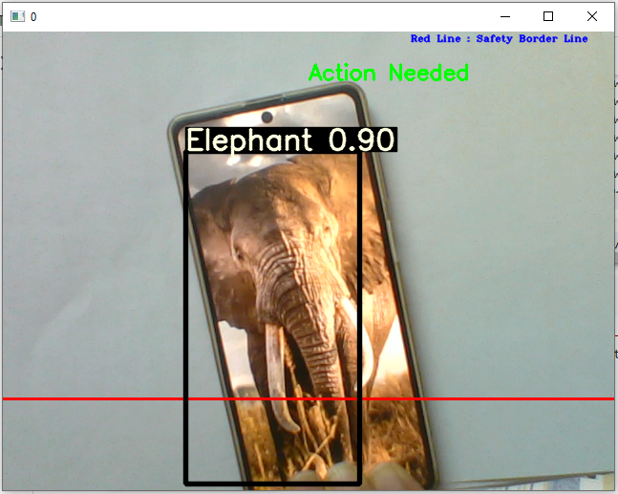
Objective:
Train and deploy a Object detection model to detect elephant and
alert the responsible department about their movement away from
marked Forest area.

Slide 3
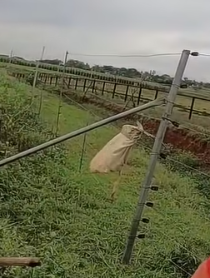
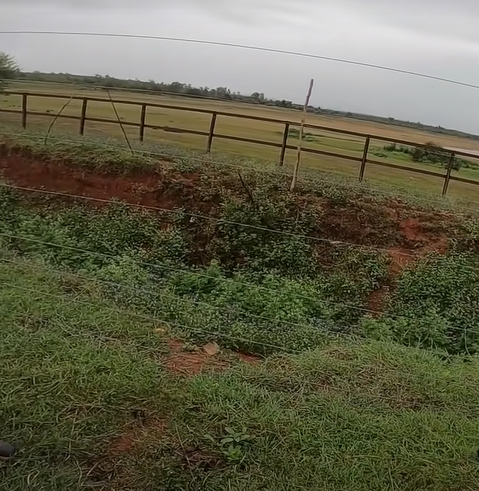
Existing Solution:
Railway-Line Fence
Trenching
Electric Fencing
Issues with existing Solution:
Process of laying Railway-Line Fence is costly as it requires large quantity of iron.
Trenching is not an effective model of defense as in most cases elephants
cross them with ease, proving money spent in trenching in vain.
Cost of laying Electric Fencing is high and it also requires cost for maintenance.
In some cases elephants have destroyed this line, which shows it is not a best solution.
Sometimes combination of above solutions are used which incur a lot of money for
for the department in charge of it.

Slide 4
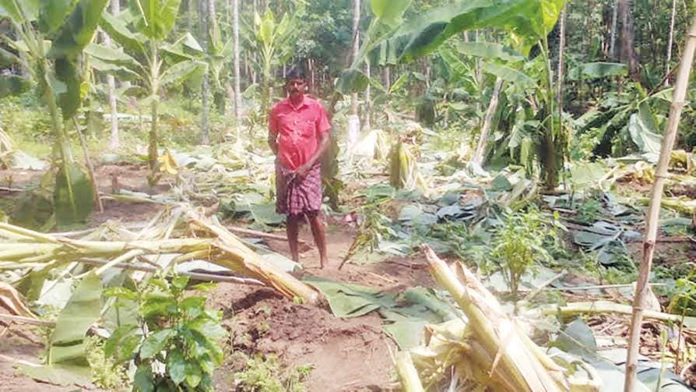
Below research paper shows crop raiding by elephants
around Bannergatta National Park range.
https://www.currentscience.ac.in/Volumes/113/01/0161.pdf
Crop loss due to elephants
Benefits from New Solution:
New solution implemented will directly alert the responsible department,
where as older ones did not. By the time Department get information
the elephants would have destroyed the farm products.
This needed a system to alert department before elephants enter the non forest zone.
This new solution is way too cost effective as it requires only a device to be setup
in buffer zone between Forest and agriculture land. This solution used along with existing
solutions will be effective in protecting farmers crops.
This will raise an alarm to department before elephants try attempt to cross the D-Line.
This alert will help officials to shoo away the elephants back to the forest area.

Slide 5
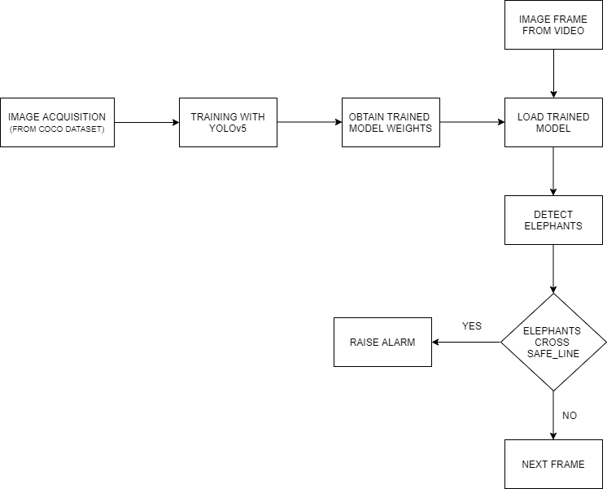

Slide 6
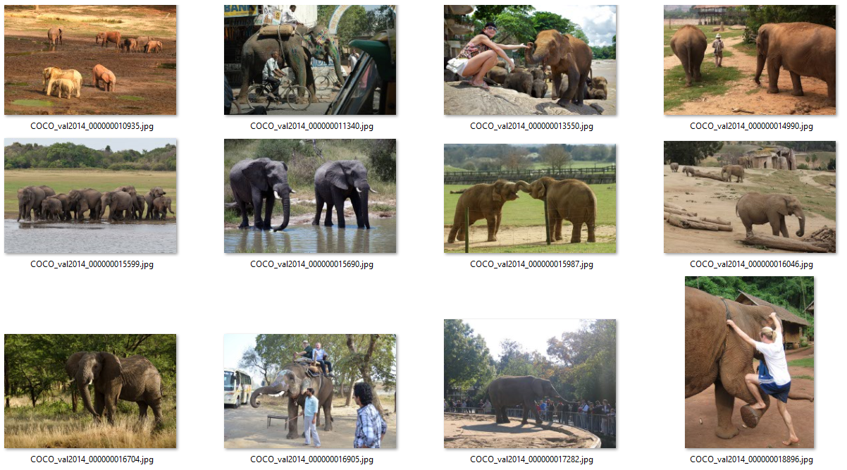
DATSET
Elephant images are subsampled from coco dataset for training.
Annotated using makesense.ai to get resp. .TXT files.
Train – 1300 images
Test – 400 images
SAMPLE IMAGES

Slide 7
MODEL TRAINING
Trained using yoloV5 architecture.
Train – 1300 images
Test – 400 images
Train-Val split : 75 – 25
Number of classes : 1
Class name : “Elephant”
Number of epochs : 1800
mAP@0.5 : 0.86 / 86%

Slide 8
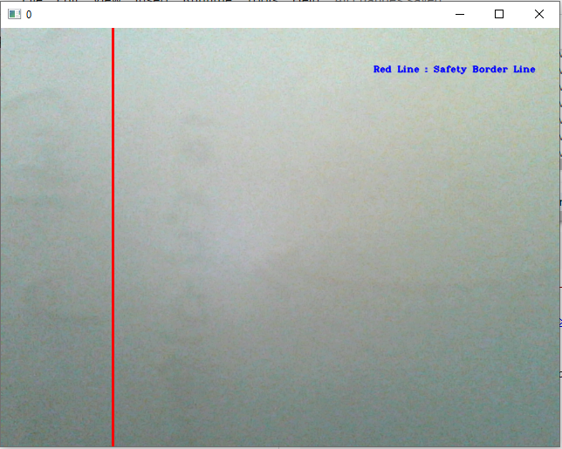
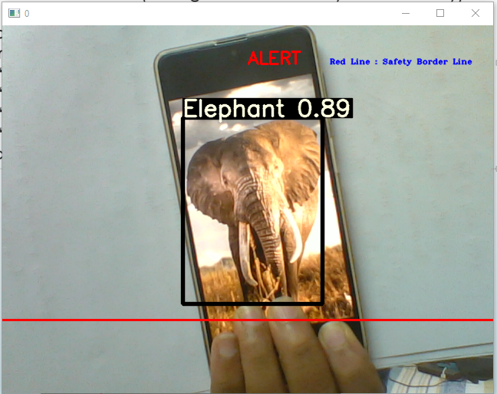
Output Window:
Red Line : Buffer Line (changeable horizontally and vertically)
It can be adjusted by changing Orientation parameter in code.
4 Orientation are defined:
“bt” (bottom-top)
“tb” (top-bottom)
“lr” (left-right)
“rl” (right-left)
(second portion is buffer zone)
Forest Area
Buffer Area
O/P window with ‘rl’ Orientation
O/P window with ‘tb’ Orientation and
No detection in buffer zone
O/P window with ‘tb’ Orientation and
Detection in buffer zone

Slide 9
Future work:
Try with different frameworks and compare results to get best model
for accurate detection.
Train with adding images from night vision IR dataset.
Evaluate if a single model detects optimally at both day-time and night.
Integrate with edge devices for field application.
Conclusion:
This new system can efficiently alert the forest department about any elephants
moving away from forest lands.
This can save the valuable crops of framers by restricting them crop-raiding.
This system can also be utilized by framers around their farms.
This system used along with any conventional method(for delaying the movement)
can help us restrict elephants from entering the farm lands.

Slide 10
Thank You

